Slide 1
MODULE-2
WEB Services Protocols

Slide 2
Application Programmable Interface
Lesson 1
Introduction to Web Services and REST API

Slide 3
Web Services (User)
http://www.XYZ.com/home/full-course-catalog
Introduction to Cloud
Introduction to Python
Introduction to Web Services
Notes:
When a person uses the internet, one of the protocols that helps keep all of the magic behind the scenes, is Hyper Text Transfer Protocol (HTTP). All of the Web Pages and Folders that are navigated are accessed through a URL that usually starts with a domain address that is purchased through a service provider that likes to host websites or provides services to a company that host the servers. In the example, a full course catalog is being searched by requesting the page from a company that owns XYZ.com, drills down into the home page and than finds the full-course-catalog that is active. Continuing to click on the options will allow the user to explore the site with our much complexity except for being slightly unfamiliar with the particular web site.

Slide 4
Web Services (Node)
XML
eXtensible Markup Language
JSON
Java Script Oriented Notation
REST
REpresentational State Transfer
Notes:
Web Services would be considered the languages and protocols used to get anything meaningfully done between a client and the information required.
XML- The eXtensible Markup Language (XML) document carries settings that pertain to certain configurations on the devices that the Web Page has access to. Tags are the primary XML likes to encapsulate the data being transferred.
JSON- Java Script Oriented Notation is another language that performs a similar role to that of XML but has a different display that some programmers are much more comfortable working with due to the way queries can ne read and obtained. The use of tags are not repeated for encapsulation as with XML.
WSDL- Web Services Description Language are a set of libraries that are referenced by an XML or other programming language to manipulate settings on a device. They are in essence a type of XML Schema that can provides input and output as objects are passed.
SOAP- Simple Object Access Protocol is a client that was used for communicating with a web service. The use of a WSDL was required to translate one type of API with another.
REST - Representational State Transfer is the latest means to communicate with a web service. It hides the complexity of the WSDL so that pointing to a particular library with another variable is not necessary.

Slide 5

Web Services (Transport)
XML
JSON
WSDL
REST
SOAP
SSH
HTTP
Notes:
XML, JSON, REST , SOAP and WSDL’s all are used to interface with the configuration. All of these protocols would be sent over transport protocols that understand objects. HTTP is a common service that is used for these protocols to interact with the Web Service. Common Object Request Broker Architecture (CORBA) was also used due to it’s ability to deal with an object oriented project. SSH is primarily used as the transport of choice to send and receive strings from a router but is also being used to transport encoded documents as well.

Slide 6



REST Overview
Sending Data
Configuration
Receiving Data
HTTP(s)
HTTP
Source
MGMT Console
Post , Modify, Delete
Tree (MIM)
Get
HTTP(s)
Source
REST
Appliance
Notes:
Representational State Transfer is a method of communication of a client and server using an http style of accessing network objects instead of traditional SOAP, RPC or CORBA manipulation of objects. The common “POST”, “GET”, “DELETE” and “MODIFY actions can be used in a URL format to access a tree of data called a Management Information Model. REST itself is not secure but can leverage the Secure Socket Layer (443) to enforce security.

Slide 7
Management Information Model
Post , Get, Modify, Delete
https://ec2.us-east-2.amazonaws.com/?Action=DescribeInstances
&Version=2016-11-15
ec2
reservationSet
vpcSet
reservationId
VpcId
tagSet
vpcId
Name
Instructor
Name
Entity
Notes:
Since RESTful API is a good way to parse a Tree like structure, most vendors deploy a type of Management Information Model or MIM to access one or a set of objects. These objects can be standalone, a parent, or a child structure. A good example of this structure would be hardware devices that contain chassis, line cards, ports and supports. There is a hierarchical form of these objects that can be learned and used to easily manipulate or query at any given time.

Slide 8
Management Information Model
HTTP://10.1.1.1/root/parent1/child2/object3
root
parent1
parent2
child1
child2
child3
child4
object1
object2
object3
object4
object5
object6
object7
object8

Slide 9
Management Information Model
HTTP://10.1.1.1/root/parent1/child2/object3
root
parent1
parent2
child1
child2
child3
child4
object1
object2
object3
object4
object5
object6
object7
object8

Slide 10
What is REST?
HTTP://10.1.1.1/root/parent1/child2/object3
root
parent1
parent2
child1
child2
child3
child4
object1
object2
object3
object4
object5
object6
object7
object8

Slide 11
What is REST?
HTTP://10.1.1.1/root/parent1/child2/object3
root
parent1
parent2
child1
child2
child3
child4
object1
object2
object3
object4
object5
object6
object7
object8

Slide 12
The MIM Tree
HTTP://10.1.1.1/root/parent1/child2/object3
root
parent1
parent2
child1
child2
child3
child4
object1
object2
object3
object4
object5
object6
object7
object8

Slide 13
The MIM Tree
HTTP://10.1.1.1/api/chassis1/linecard2/port1
ec2
vpcs
Instances
Tags
VpcId
Tags
SecurityGroups
Name
Instructor
Name
Entity
GroupId
GroupName
Notes:
The MIM is also being applied to the networking appliances. By leveraging the construction of the parts of the device, we can now take advantage of a hierarchical approach. We can see in this example of how this can be done by following a folder view very similar to that of searching a web site. The API is the main folder, followed by a Chassis that contains multiple line cards and ports.

Slide 14
The MIM Tree
HTTP://10.1.1.1/api/chassis1/linecard2/port1
ec2
vpcs
Instances
Tags
VpcId
Tags
SecurityGroups
Name
Instructor
Name
Entity
GroupId
GroupName

Slide 15
The MIM Tree
HTTP://10.1.1.1/api/chassis1/linecard2/port1
ec2
vpcs
Instances
Tags
VpcId
Tags
SecurityGroups
Name
Instructor
Name
Entity
GroupId
GroupName

Slide 16
The MIM Tree
HTTP://10.1.1.1/api/chassis1/linecard2/port1
ec2
vpcs
Instances
Tags
VpcId
Tags
SecurityGroups
Name
Instructor
Name
Entity
GroupId
GroupName

Slide 17
The MIM Tree
HTTP://10.1.1.1/api/chassis1/linecard2/port1
ec2
vpcs
Instances
Tags
VpcId
Tags
SecurityGroups
Name
Instructor
Name
Entity
GroupId
GroupName

Slide 18
Object Naming
Distinguished Name
dn = api/mo/chassis1/linecard1/port1

Slide 19
Encoded Documents
Sending Strings
Configuration
Receiving Strings
HTTP(s)
HTTP
Source
MGMT
Console
Post , Modify, Delete, Get
<?xml version="1.0" encoding=“UTF-8"?>
<xs:schema xmlns:xs="http://www.w3.org/2001/XMLSchema">
<xs:element name="contact">
<xs:complexType>
<xs:sequence>
<xs:element name="name" type="xs:string" />
<xs:element name="company" type="xs:string" />
<xs:element name="phone" type="xs:int" />
</xs:sequence>
</xs:complexType>
</xs:element>
</xs:schema>
{
Company: {
Employee:{
‘FirstName’: ’Tanmay’,
‘LastName’ : ‘Patil’,
‘ContactNo’:’1234567890’,
‘Email’: ‘tanmaypatil@xyz.com’,
‘Address’: {
‘City’: ‘Banglore’,
‘State’: ‘Karnataka’,
‘Zip’ : ‘560212’
}
}
}
}
Tree (MIM)
HTTP(s)
REST
Source
Destination
Notes:
Now that the MIM has been presented, we can now go back to what type of data is being used over this RESTful interface. With routers and switches, the CLI would enable the user to send and receive strings. With a RESTful call, encoded documents make up the string being sent and received from a node in the form of XML and/or JSON. The manufacturer decides which one to support or both.

Slide 20
Application Programmable Interface
Lesson 2
Extensible Markup Language(XML)
and
Java Script Oriented Notation (JSON)

Slide 21
What is XML?
<?xml version="1.0" encoding=“UTF-8"?>
<xs:schema xmlns:xs="http://www.w3.org/2001/XMLSchema">
<xs:element name="contact">
<xs:complexType>
<xs:sequence>
<xs:element name="name" type="xs:string" />
<xs:element name="company" type="xs:string" />
<xs:element name="phone" type="xs:int" />
</xs:sequence>
</xs:complexType>
</xs:element>
</xs:schema>
Notes:
The eXstensible Mark up Language (XML) defines a set of rules for encoding documents. A simple definition than quoting another standards body might be in order here. A device owns a set of variables or parameters that can be read or written to if the proper API is used such as REST, Python and others. XML uses a concept called “tags” to identify objects or parameters that are known by the receiving device. For the purpose of this application, a DOM or Data Object Model is the application for learning XML. A DOM allows the data to be parsed in a tree like structure.

Slide 22
What is XML?
<?xml version="1.0" encoding=“UTF-8"?>
<xs:schema xmlns:xs="http://www.w3.org/2001/XMLSchema">
<xs:element name="contact">
<xs:complexType>
<xs:sequence>
<xs:element name="name" type="xs:string" />
<xs:element name="company" type="xs:string" />
<xs:element name="phone" type="xs:int" />
</xs:sequence>
</xs:complexType>
</xs:element>
</xs:schema>

Slide 23
What is XML?
<?xml version="1.0" encoding=“UTF-8"?>
<xs:schema xmlns:xs="http://www.w3.org/2001/XMLSchema">
<xs:element name="contact">
<xs:complexType>
<xs:sequence>
<xs:element name="name" type="xs:string" />
<xs:element name="company" type="xs:string" />
<xs:element name="phone" type="xs:int" />
</xs:sequence>
</xs:complexType>
</xs:element>
</xs:schema>
Tags
Tags

Slide 24
What is XML?
<?xml version="1.0" encoding=“UTF-8"?>
<xs:schema xmlns:xs="http://www.w3.org/2001/XMLSchema">
<xs:element name="contact">
<xs:complexType>
<xs:sequence>
<xs:element name="name" type="xs:string" />
<xs:element name="company" type="xs:string" />
<xs:element name="phone" type="xs:int" />
</xs:sequence>
</xs:complexType>
</xs:element>
</xs:schema>
Tags
Tags

Slide 25
What is XML?
<?xml version="1.0" encoding=“UTF-8"?>
<xs:schema xmlns:xs="http://www.w3.org/2001/XMLSchema">
<xs:element name="contact">
<xs:complexType>
<xs:sequence>
<xs:element name="name" type="xs:string" />
<xs:element name="company" type="xs:string" />
<xs:element name="phone" type="xs:int" />
</xs:sequence>
</xs:complexType>
</xs:element>
</xs:schema>
Tags
Tags

Slide 26
What is XML?
<?xml version="1.0" encoding=“UTF-8"?>
<xs:schema xmlns:xs="http://www.w3.org/2001/XMLSchema">
<xs:element name="contact">
<xs:complexType>
<xs:sequence>
<xs:element name="name" type="xs:string" />
<xs:element name="company" type="xs:string" />
<xs:element name="phone" type="xs:int" />
</xs:sequence>
</xs:complexType>
</xs:element>
</xs:schema>
Tags
Tags

Slide 27
What is XML?
<?xml version="1.0" encoding=“UTF-8"?>
<xs:schema xmlns:xs="http://www.w3.org/2001/XMLSchema">
<xs:element name="contact">
<xs:complexType>
<xs:sequence>
<xs:element name="name" type="xs:string" />
<xs:element name="company" type="xs:string" />
<xs:element name="phone" type="xs:int" />
</xs:sequence>
</xs:complexType>
</xs:element>
</xs:schema>

Slide 28
XML Format
<?xml version="1.0"?>
<Company>
<Employee>
<FirstName>Tanmay</FirstName>
<LastName>Patil</LastName>
<ContactNo>1234567890</ContactNo>
<Email>tanmaypatil@xyz.com</Email>
<Address>
<City>Bangalore</City>
<State>Karnataka</State>
<Zip>560212</Zip>
</Address>
</Employee>
</Company>
Notes:
The Hierchial Nature of XML is all in the formatting. In this case, the “Company”, and “Employee” tags have been separated to show clarity on where the encapsulation is taking place. However, the “FirstName” tag begins and ends on the same line. This can be very distracting when trying to decode long strings of txt. Reverting back to that format with the “Address” tag shows the consistence we are looking for.

Slide 29
XML Format
<?xml version="1.0"?>
<Company>
<Employee>
<FirstName>Tanmay</FirstName>
<LastName>Patil</LastName>
<ContactNo>1234567890</ContactNo>
<Email>tanmaypatil@xyz.com</Email>
<Address>
<City>Bangalore</City>
<State>Karnataka</State>
<Zip>560212</Zip>
</Address>
</Employee>
</Company>

Slide 30
XML Format
<?xml version="1.0"?>
<Company>
<Employee>
<FirstName>Tanmay</FirstName>
<LastName>Patil</LastName>
<ContactNo>1234567890</ContactNo>
<Email>tanmaypatil@xyz.com</Email>
<Address>
<City>Bangalore</City>
<State>Karnataka</State>
<Zip>560212</Zip>
</Address>
</Employee>
</Company>

Slide 31
XML Format
<?xml version="1.0"?>
<Company>
<Employee>
<FirstName>Tanmay</FirstName>
<LastName>Patil</LastName>
<ContactNo>1234567890</ContactNo>
<Email>tanmaypatil@xyz.com</Email>
<Address>
<City>Bangalore</City>
<State>Karnataka</State>
<Zip>560212</Zip>
</Address>
</Employee>
</Company>

Slide 32
XML Format
<?xml version="1.0"?>
<Company>
<Employee>
<FirstName>Tanmay</FirstName>
<LastName>Patil</LastName>
<ContactNo>1234567890</ContactNo>
<Email>tanmaypatil@xyz.com</Email>
<Address>
<City>Bangalore</City>
<State>Karnataka</State>
<Zip>560212</Zip>
</Address>
</Employee>
</Company>

Slide 33
XML Format
<?xml version="1.0"?>
<Company>
<Employee>
<FirstName>Tanmay</FirstName>
<LastName>Patil</LastName>
<ContactNo>1234567890</ContactNo>
<Email>tanmaypatil@xyz.com</Email>
<Address>
<City>Bangalore</City>
<State>Karnataka</State>
<Zip>560212</Zip>
</Address>
</Employee>
</Company>

Slide 34
What is JSON?
{Company: {Employee:{‘FirstName’: ’Tanmay’,‘LastName’ : ‘Patil’,‘ContactNo’:’1234567890’,‘Email’: ‘tanmaypatil@xyz.com’,’Address’:‘City’: ‘Banglore’,‘State’: ‘Karnataka’,‘Zip’ : ‘560212’}}}
Notes:
JSON can be tricky at first when displayed. Most text applications will interpret all of the options as one line, which makes JSON very difficult to separate out manually. Although the line appears to be a layered python dictionary, the beginning and end of items is not accomplished by using tags as with XML. Instead, the hierarchy is laid out with an indentation mechanism similar to that of Python, Pearl or Java.

Slide 35
Formatted JSON
{
Company: {
Employee:{
‘FirstName’: ’Tanmay’,
‘LastName’ : ‘Patil’,
‘ContactNo’:’1234567890’,
‘Email’: ‘tanmaypatil@xyz.com’,
‘Address’: {
‘City’: ‘Banglore’,
‘State’: ‘Karnataka’,
‘Zip’ : ‘560212’
}
}
}
}
Notes:
When the JSON text os cleaned up by a formatting tool, the parameters and Indentation make it much more readable than XML. This language also seems to fit perfectly when attempting to query the device on what variables and parameters have changed or have been updated.

Slide 36
Application Programmable Interface
Lesson 3
Data Models

Slide 37
Schema Overview
CLIENT
A
SERVER / DEVICE
B
File
C
A
D
E
F
Notes:
The XML Schema is the heart and soul to what can be passed to a device to manipulate the configuration file. The file itself is in an xml format that has a series of options that it allows for input and provides a viable output that is recognized by the API that uses it. The example above show the very basic workings of an XML schema. The Client on the left is attempting to modify a configuration on a device. The “A” represents and option that is being changed or queried. The Client will send a POST action to the XML-Schema. The “A” configuration is recognized by the XML-Schema as a valid tag input and will provide an output to inform the originator of what has been updated. The configuration file is changed according to the XML-Schema.
If a different object that is not recognized by the XML-Schema is used, a rejection will be sent back to the originator and the configuration file is not updated.

Slide 38
Schema
A
B
File
C
A
D
E
F

Slide 39
Schema Overview
A
B
File
POST
C
A
D
E
F

Slide 40
Schema Overview
A
is in the
Schema File!
A
B
File
POST
C
A
D
E
F

Slide 41
Schema Overview
A
B
File
POST
C
A
D
E
F

Slide 42
Schema Overview
A
Update
B
File
POST
C
A
A
D
E
F

Slide 43
Schema Overview
A
B
File
POST
C
G
A
D
E
F

Slide 44
Schema Overview
A
B
File
REJECT
C
G
A
D
E
F

Slide 45
Application Programmable Interface
Lesson 4
Modifying the Schema

Slide 46
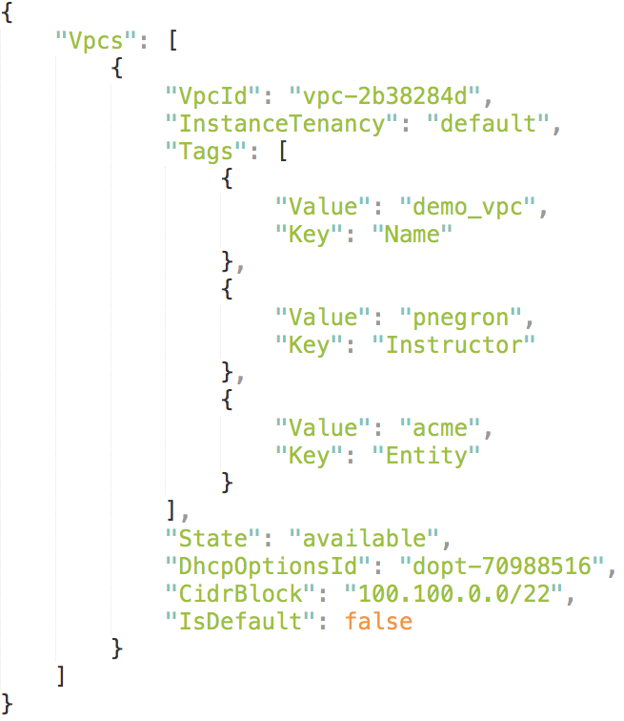
Using AWS CLI
Input
User Prompt> aws ec2 describe-vpcs --region us-west-2 --profile ipwsp
Output
Notes:
The AWS Command Line Interface (AWS CLI) is a unified tool that provides a consistent interface for interacting with all parts of AWS. As you can see, commands submitted using AWS CLI will return JSON data.
In this example, we are querying the AWS profile ’ipwsp’ defined in our ‘.aws/credentials’ file within us-west-2 (Oregon) for all VPCs in this region.

Slide 47
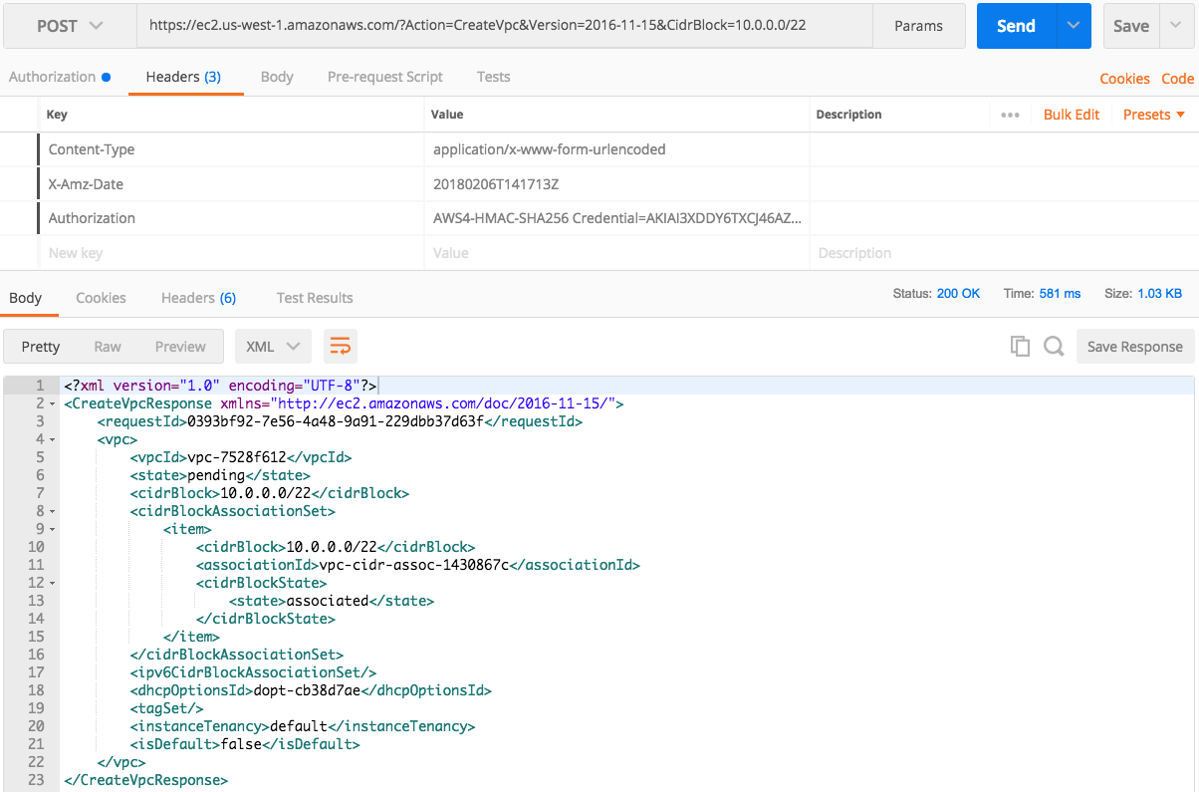
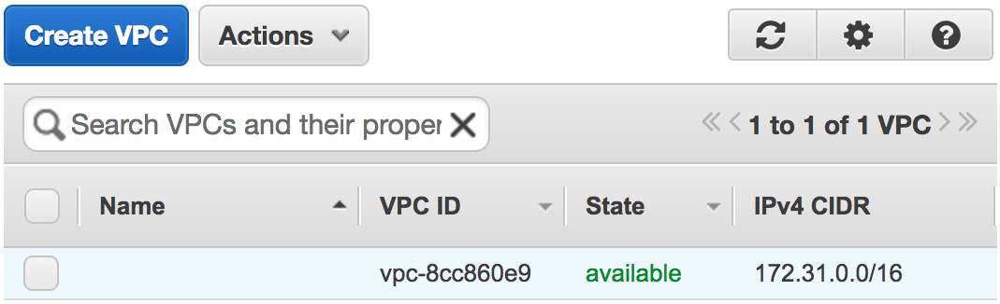
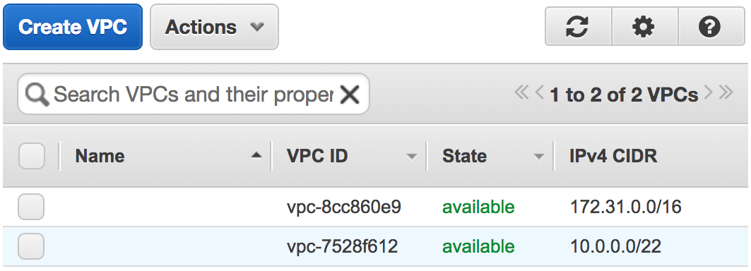
Using POSTMAN
Notes:
Postman is tool that can help facilitate the same actions as Curl but can POST with more of a clear layout. The URL is provided at the top of the document. Since POST was chosen as the action, the user will add parameters within the URL path (see CidrBlock). When making RESTful calls to AWS, the only output option offered is XML (as seen in the screenshot above).

Slide 48
Using Python with an API
from boto3 import Session
# AWS Connection Variables
service_name = 'ec2’
access_key = 'AWSACCESSKEYIDSAMPLE’
secret_key = 'A47#@AWSSECRETACCESSKEYSAMPLE$5dg6357f3*’
region = 'us-west-1’
vpc_cidr = '10.0.0.0/22’
# Establish Session with AWS
aws = Session()
session = aws.client( service_name,
region_name=region,
aws_access_key_id=access_key,
aws_secret_access_key=secret_key
)
# Create new VPC
new_vpc = session.create_vpc(CidrBlock=vpc_cidr)
"Vpc": {
"VpcId": "vpc-c37ea0a4",
"InstanceTenancy": "default",
"Tags": [],
"CidrBlockAssociationSet": [
{
"AssociationId": "vpc-cidr-assoc-9603b5fe",
"CidrBlock": "10.0.0.0/22",
"CidrBlockState": {
"State": "associated"
}
}
],
"Ipv6CidrBlockAssociationSet": [],
"State": "pending",
"DhcpOptionsId": "dopt-cb38d7ae",
"CidrBlock": "10.0.0.0/22",
"IsDefault": false
}
Notes:
Many vendors are beginning to create a native Python API that can interact with the schema on the appliance. This allows the user to leverage the power of automation by repeating actions over and over as well as taking advantage of an Object Oriented programming approach to manage the flow of the script easier.

Slide 49
Using Python with an API
from boto3 import Session
# AWS Connection Variables
service_name = 'ec2’
access_key = 'AWSACCESSKEYIDSAMPLE’
secret_key = 'A47#@AWSSECRETACCESSKEYSAMPLE$5dg6357f3*’
region = 'us-west-1’
vpc_cidr = '10.0.0.0/22’
# Establish Session with AWS
aws = Session()
session = aws.client( service_name,
region_name=region,
aws_access_key_id=access_key,
aws_secret_access_key=secret_key
)
# Create new VPC
new_vpc = session.create_vpc(CidrBlock=vpc_cidr)
"Vpc": {
"VpcId": "vpc-c37ea0a4",
"InstanceTenancy": "default",
"Tags": [],
"CidrBlockAssociationSet": [
{
"AssociationId": "vpc-cidr-assoc-9603b5fe",
"CidrBlock": "10.0.0.0/22",
"CidrBlockState": {
"State": "associated"
}
}
],
"Ipv6CidrBlockAssociationSet": [],
"State": "pending",
"DhcpOptionsId": "dopt-cb38d7ae",
"CidrBlock": "10.0.0.0/22",
"IsDefault": false
}
Notes:
Many vendors are beginning to create a native Python API that can interact with the schema on the appliance. This allows the user to leverage the power of automation by repeating actions over and over as well as taking advantage of an Object Oriented programming approach to manage the flow of the script easier.

Slide 50
Using Python with an API
from boto3 import Session
# AWS Connection Variables
service_name = 'ec2’
access_key = 'AWSACCESSKEYIDSAMPLE’
secret_key = 'A47#@AWSSECRETACCESSKEYSAMPLE$5dg6357f3*’
region = 'us-west-1’
vpc_cidr = '10.0.0.0/22’
# Establish Session with AWS
aws = Session()
session = aws.client( service_name,
region_name=region,
aws_access_key_id=access_key,
aws_secret_access_key=secret_key
)
# Create new VPC
new_vpc = session.create_vpc(CidrBlock=vpc_cidr)
"Vpc": {
"VpcId": "vpc-c37ea0a4",
"InstanceTenancy": "default",
"Tags": [],
"CidrBlockAssociationSet": [
{
"AssociationId": "vpc-cidr-assoc-9603b5fe",
"CidrBlock": "10.0.0.0/22",
"CidrBlockState": {
"State": "associated"
}
}
],
"Ipv6CidrBlockAssociationSet": [],
"State": "pending",
"DhcpOptionsId": "dopt-cb38d7ae",
"CidrBlock": "10.0.0.0/22",
"IsDefault": false
}
Notes:
Many vendors are beginning to create a native Python API that can interact with the schema on the appliance. This allows the user to leverage the power of automation by repeating actions over and over as well as taking advantage of an Object Oriented programming approach to manage the flow of the script easier.

Slide 51
Using Python with an API
from boto3 import Session
# AWS Connection Variables
service_name = 'ec2’
access_key = 'AWSACCESSKEYIDSAMPLE’
secret_key = 'A47#@AWSSECRETACCESSKEYSAMPLE$5dg6357f3*’
region = 'us-west-1’
vpc_cidr = '10.0.0.0/22’
# Establish Session with AWS
aws = Session()
session = aws.client( service_name,
region_name=region,
aws_access_key_id=access_key,
aws_secret_access_key=secret_key
)
# Create new VPC
new_vpc = session.create_vpc(CidrBlock=vpc_cidr)
"Vpc": {
"VpcId": "vpc-c37ea0a4",
"InstanceTenancy": "default",
"Tags": [],
"CidrBlockAssociationSet": [
{
"AssociationId": "vpc-cidr-assoc-9603b5fe",
"CidrBlock": "10.0.0.0/22",
"CidrBlockState": {
"State": "associated"
}
}
],
"Ipv6CidrBlockAssociationSet": [],
"State": "pending",
"DhcpOptionsId": "dopt-cb38d7ae",
"CidrBlock": "10.0.0.0/22",
"IsDefault": false
}
Notes:
Many vendors are beginning to create a native Python API that can interact with the schema on the appliance. This allows the user to leverage the power of automation by repeating actions over and over as well as taking advantage of an Object Oriented programming approach to manage the flow of the script easier.

Slide 52
Using Python with an API
from boto3 import Session
# AWS Connection Variables
service_name = 'ec2’
access_key = 'AWSACCESSKEYIDSAMPLE’
secret_key = 'A47#@AWSSECRETACCESSKEYSAMPLE$5dg6357f3*’
region = 'us-west-1’
vpc_cidr = '10.0.0.0/22’
# Establish Session with AWS
aws = Session()
session = aws.client( service_name,
region_name=region,
aws_access_key_id=access_key,
aws_secret_access_key=secret_key
)
# Create new VPC
new_vpc = session.create_vpc(CidrBlock=vpc_cidr)
"Vpc": {
"VpcId": "vpc-c37ea0a4",
"InstanceTenancy": "default",
"Tags": [],
"CidrBlockAssociationSet": [
{
"AssociationId": "vpc-cidr-assoc-9603b5fe",
"CidrBlock": "10.0.0.0/22",
"CidrBlockState": {
"State": "associated"
}
}
],
"Ipv6CidrBlockAssociationSet": [],
"State": "pending",
"DhcpOptionsId": "dopt-cb38d7ae",
"CidrBlock": "10.0.0.0/22",
"IsDefault": false
}
Notes:
Many vendors are beginning to create a native Python API that can interact with the schema on the appliance. This allows the user to leverage the power of automation by repeating actions over and over as well as taking advantage of an Object Oriented programming approach to manage the flow of the script easier.

Slide 53
Application Programmable Interface
Lesson 5
Data Manipulation and Extraction

Slide 54

Loading JSON
import simplejson as json
file = "/home/student/parse_json.json"
test = open(file, 'r')
readfile = test.read()
data = json.loads(readfile)
test.close()
print data
{'TOP_OBJ': {'attributes': {'ownerKey': u'', 'name': 'TEST1_OBJECT',
'descr': 'This is a main section', 'ownerTag': u''}, 'children': [{'OBJ1': {'attributes':
{'ownerKey': u'', 'name': 'TEST2_OBJECT', 'descr': 'This is a second section', 'ownerTag': u''}}},
{'OBJ2': {'attributes': {'ownerKey': u'', 'name': 'TEST2_OBJECT',
'descr': 'This is a second section', 'ownerTag': u''}, 'children': [{'SUB_OBJ2':
{'attributes': {'prio': '1', 'type': 'String', 'name': 'TEST3_OBJECT', 'descr': 'This is third section'}}}]}}]}}
Notes:
Data extraction is an important facet to why things are changing so quickly. No longer is a network looked at as being a means of just piping traffic from one point to another. It is also a represents a central location where data can be extracted to help Data Scientist forecast financial objectives and future use of company assets. JSON is becoming more and more popular as a way to represent the data with a key/value pair.

Slide 55
Parsing JSON (Keys)
{
"TOP_OBJ": {
"attributes": {
"descr": "This is a main section",
"name": "TEST1_OBJECT",
"ownerKey": "",
"ownerTag": ""
},
"children": [{
"OBJ1": {
"attributes": {
"descr": "This is a second section",
"name": "TEST2_OBJECT",
"ownerKey": "",
"ownerTag": ""
}
}
}, {
"OBJ2": {
"attributes": {
"descr": "This is a second section",
"name": "TEST2_OBJECT",
"ownerKey": "",
"ownerTag": ""
},
"children": [{
"SUB_OBJ2": {
"attributes": {
"descr": "This is third section",
"type": "String",
"name": "TEST3_OBJECT",
"prio": "1"
}
}
}]
}
}]
}
}
import simplejson as json
file = "/home/student/parse_json.json"
test = open(file, 'r')
readfile = test.read()
data = json.loads(readfile)
test.close()
data1 = data["TOP_OBJ"]["attributes"]
print data1["name"]
Notes:
In this example, a user is trying to extract the the name of the ‘TOP_OBJ’ located under the attributes section of that object. Regular expressions was the method used by parsing a string of text. With JSON, the text is organized like a Python dictionary that is nested by using dictionaries as values of other keys. This allows the user to call out an individual parameter without using special characters as with regular expressions.

Slide 56
Parsing JSON (Keys)
{
"TOP_OBJ": {
"attributes": {
"descr": "This is a main section",
"name": "TEST1_OBJECT",
"ownerKey": "",
"ownerTag": ""
},
"children": [{
"OBJ1": {
"attributes": {
"descr": "This is a second section",
"name": "TEST2_OBJECT",
"ownerKey": "",
"ownerTag": ""
}
}
}, {
"OBJ2": {
"attributes": {
"descr": "This is a second section",
"name": "TEST2_OBJECT",
"ownerKey": "",
"ownerTag": ""
},
"children": [{
"SUB_OBJ2": {
"attributes": {
"descr": "This is third section",
"type": "String",
"name": "TEST3_OBJECT",
"prio": "1"
}
}
}]
}
}]
}
}
import simplejson as json
file = "/home/student/parse_json.json"
test = open(file, 'r')
readfile = test.read()
data = json.loads(readfile)
test.close()
data1 = data["TOP_OBJ"]["attributes"]
print data1["name"]

Slide 57
Parsing JSON (Keys)
{
"TOP_OBJ": {
"attributes": {
"descr": "This is a main section",
"name": "TEST1_OBJECT",
"ownerKey": "",
"ownerTag": ""
},
"children": [{
"OBJ1": {
"attributes": {
"descr": "This is a second section",
"name": "TEST2_OBJECT",
"ownerKey": "",
"ownerTag": ""
}
}
}, {
"OBJ2": {
"attributes": {
"descr": "This is a second section",
"name": "TEST2_OBJECT",
"ownerKey": "",
"ownerTag": ""
},
"children": [{
"SUB_OBJ2": {
"attributes": {
"descr": "This is third section",
"type": "String",
"name": "TEST3_OBJECT",
"prio": "1"
}
}
}]
}
}]
}
}
import simplejson as json
file = "/home/student/parse_json.json"
test = open(file, 'r')
readfile = test.read()
data = json.loads(readfile)
test.close()
data1 = data["TOP_OBJ"]["attributes"]
print data1["name"]

Slide 58
Parsing JSON (Keys)
{
"TOP_OBJ": {
"attributes": {
"descr": "This is a main section",
"name": "TEST1_OBJECT",
"ownerKey": "",
"ownerTag": ""
},
"children": [{
"OBJ1": {
"attributes": {
"descr": "This is a second section",
"name": "TEST2_OBJECT",
"ownerKey": "",
"ownerTag": ""
}
}
}, {
"OBJ2": {
"attributes": {
"descr": "This is a second section",
"name": "TEST2_OBJECT",
"ownerKey": "",
"ownerTag": ""
},
"children": [{
"SUB_OBJ2": {
"attributes": {
"descr": "This is third section",
"type": "String",
"name": "TEST3_OBJECT",
"prio": "1"
}
}
}]
}
}]
}
}
import simplejson as json
file = "/home/student/parse_json.json"
test = open(file, 'r')
readfile = test.read()
data = json.loads(readfile)
test.close()
data1 = data["TOP_OBJ"]["attributes"]
print data1["name"]

Slide 59
Parsing JSON (Keys)
{
"TOP_OBJ": {
"attributes": {
"descr": "This is a main section",
"name": "TEST1_OBJECT",
"ownerKey": "",
"ownerTag": ""
},
"children": [{
"OBJ1": {
"attributes": {
"descr": "This is a second section",
"name": "TEST2_OBJECT",
"ownerKey": "",
"ownerTag": ""
}
}
}, {
"OBJ2": {
"attributes": {
"descr": "This is a second section",
"name": "TEST2_OBJECT",
"ownerKey": "",
"ownerTag": ""
},
"children": [{
"SUB_OBJ2": {
"attributes": {
"descr": "This is third section",
"type": "String",
"name": "TEST3_OBJECT",
"prio": "1"
}
}
}]
}
}]
}
}
import simplejson as json
file = "/home/student/parse_json.json"
test = open(file, 'r')
readfile = test.read()
data = json.loads(readfile)
test.close()
data1 = data["TOP_OBJ"]["attributes"]
print data1["name"]

Slide 60
Parsing JSON (Keys)
{
"TOP_OBJ": {
"attributes": {
"descr": "This is a main section",
"name": "TEST1_OBJECT",
"ownerKey": "",
"ownerTag": ""
},
"children": [{
"OBJ1": {
"attributes": {
"descr": "This is a second section",
"name": "TEST2_OBJECT",
"ownerKey": "",
"ownerTag": ""
}
}
}, {
"OBJ2": {
"attributes": {
"descr": "This is a second section",
"name": "TEST2_OBJECT",
"ownerKey": "",
"ownerTag": ""
},
"children": [{
"SUB_OBJ2": {
"attributes": {
"descr": "This is third section",
"type": "String",
"name": "TEST3_OBJECT",
"prio": "1"
}
}
}]
}
}]
}
}
import simplejson as json
file = "/home/student/parse_json.json"
test = open(file, 'r')
readfile = test.read()
data = json.loads(readfile)
test.close()
data1 = data["TOP_OBJ"]["attributes"]
print data1["name"]

Slide 61
Parsing JSON (Keys)
{
"TOP_OBJ": {
"attributes": {
"descr": "This is a main section",
"name": "TEST1_OBJECT",
"ownerKey": "",
"ownerTag": ""
},
"children": [{
"OBJ1": {
"attributes": {
"descr": "This is a second section",
"name": "TEST2_OBJECT",
"ownerKey": "",
"ownerTag": ""
}
}
}, {
"OBJ2": {
"attributes": {
"descr": "This is a second section",
"name": "TEST2_OBJECT",
"ownerKey": "",
"ownerTag": ""
},
"children": [{
"SUB_OBJ2": {
"attributes": {
"descr": "This is third section",
"type": "String",
"name": "TEST3_OBJECT",
"prio": "1"
}
}
}]
}
}]
}
}
import simplejson as json
file = "/home/student/parse_json.json"
test = open(file, 'r')
readfile = test.read()
data = json.loads(readfile)
test.close()
data1 = data["TOP_OBJ"]["attributes"]
print data1["name"]

Slide 62
Parsing JSON(Lists)
{
"TOP_OBJ": {
"attributes": {
"descr": "This is a main section",
"name": "TEST1_OBJECT",
"ownerKey": "",
"ownerTag": ""
},
"children": [{
"OBJ1": {
"attributes": {
"descr": "This is a second section",
"name": "TEST2_OBJECT",
"ownerKey": "",
"ownerTag": ""
}
}
}, {
"OBJ2": {
"attributes": {
"descr": "This is a second section",
"name": "TEST2_OBJECT",
"ownerKey": "",
"ownerTag": ""
},
"children": [{
"SUB_OBJ2": {
"attributes": {
"descr": "This is third section",
"type": "String",
"name": "TEST3_OBJECT",
"prio": "1"
}
}
}]
}
}]
}
}
import simplejson as json
file = "/home/student/parse_json.json"
test = open(file, 'r')
readfile = test.read()
data = json.loads(readfile)
test.close()
data1 = data["TOP_OBJ"]["children"]
print data1[0]
print data1[1]
Notes:
In some cases, the nested dictionaries are broken up into a list of dictionaries. This helps to relax the naming space and allows the same types of keys to be reused. This is a powerful way to store the data to be extracted and looped through. It also allows the user to grab a specific value of interest that may be stored under a number of different objects.
The difference in parsing this about is paying attention to when the list begins as they are referenced by an index and not a key. The example shows how OBJ1 and OBJ2 must first be referenced by the index placement of “0” and “1” respectively before calling out the key value. The nested dictionary approach can continue once this has been accomplished.

Slide 63
Parsing JSON (Keys)
{
"TOP_OBJ": {
"attributes": {
"descr": "This is a main section",
"name": "TEST1_OBJECT",
"ownerKey": "",
"ownerTag": ""
},
"children": [{
"OBJ1": {
"attributes": {
"descr": "This is a second section",
"name": "TEST2_OBJECT",
"ownerKey": "",
"ownerTag": ""
}
}
}, {
"OBJ2": {
"attributes": {
"descr": "This is a second section",
"name": "TEST2_OBJECT",
"ownerKey": "",
"ownerTag": ""
},
"children": [{
"SUB_OBJ2": {
"attributes": {
"descr": "This is third section",
"type": "String",
"name": "TEST3_OBJECT",
"prio": "1"
}
}
}]
}
}]
}
}
import simplejson as json
file = "/home/student/parse_json.json"
test = open(file, 'r')
readfile = test.read()
data = json.loads(readfile)
test.close()
data1 = data["TOP_OBJ"]["chidren"]
print data1[0]
print data1[1]

Slide 64
Parsing JSON (Keys)
{
"TOP_OBJ": {
"attributes": {
"descr": "This is a main section",
"name": "TEST1_OBJECT",
"ownerKey": "",
"ownerTag": ""
},
"children": [{
"OBJ1": {
"attributes": {
"descr": "This is a second section",
"name": "TEST2_OBJECT",
"ownerKey": "",
"ownerTag": ""
}
}
}, {
"OBJ2": {
"attributes": {
"descr": "This is a second section",
"name": "TEST2_OBJECT",
"ownerKey": "",
"ownerTag": ""
},
"children": [{
"SUB_OBJ2": {
"attributes": {
"descr": "This is third section",
"type": "String",
"name": "TEST3_OBJECT",
"prio": "1"
}
}
}]
}
}]
}
}
import simplejson as json
file = "/home/student/parse_json.json"
test = open(file, 'r')
readfile = test.read()
data = json.loads(readfile)
test.close()
data1 = data["TOP_OBJ"]["chidren"]
print data1[0]
print data1[1]

Slide 65
Parsing JSON (Keys)
{
"TOP_OBJ": {
"attributes": {
"descr": "This is a main section",
"name": "TEST1_OBJECT",
"ownerKey": "",
"ownerTag": ""
},
"children": [{
"OBJ1": {
"attributes": {
"descr": "This is a second section",
"name": "TEST2_OBJECT",
"ownerKey": "",
"ownerTag": ""
}
}
}, {
"OBJ2": {
"attributes": {
"descr": "This is a second section",
"name": "TEST2_OBJECT",
"ownerKey": "",
"ownerTag": ""
},
"children": [{
"SUB_OBJ2": {
"attributes": {
"descr": "This is third section",
"type": "String",
"name": "TEST3_OBJECT",
"prio": "1"
}
}
}]
}
}]
}
}
import simplejson as json
file = "/home/student/parse_json.json"
test = open(file, 'r')
readfile = test.read()
data = json.loads(readfile)
test.close()
data1 = data["TOP_OBJ"]["chidren"]
print data1[0]
print data1[1]

Slide 66
Parsing JSON (Keys)
{
"TOP_OBJ": {
"attributes": {
"descr": "This is a main section",
"name": "TEST1_OBJECT",
"ownerKey": "",
"ownerTag": ""
},
"children": [{
"OBJ1": {
"attributes": {
"descr": "This is a second section",
"name": "TEST2_OBJECT",
"ownerKey": "",
"ownerTag": ""
}
}
}, {
"OBJ2": {
"attributes": {
"descr": "This is a second section",
"name": "TEST2_OBJECT",
"ownerKey": "",
"ownerTag": ""
},
"children": [{
"SUB_OBJ2": {
"attributes": {
"descr": "This is third section",
"type": "String",
"name": "TEST3_OBJECT",
"prio": "1"
}
}
}]
}
}]
}
}
import simplejson as json
file = "/home/student/parse_json.json"
test = open(file, 'r')
readfile = test.read()
data = json.loads(readfile)
test.close()
data1 = data["TOP_OBJ"]["chidren"]
print data1[0]
print data1[1]
INDEX “0”

Slide 67
Parsing JSON (Keys)
{
"TOP_OBJ": {
"attributes": {
"descr": "This is a main section",
"name": "TEST1_OBJECT",
"ownerKey": "",
"ownerTag": ""
},
"children": [{
"OBJ1": {
"attributes": {
"descr": "This is a second section",
"name": "TEST2_OBJECT",
"ownerKey": "",
"ownerTag": ""
}
}
}, {
"OBJ2": {
"attributes": {
"descr": "This is a second section",
"name": "TEST2_OBJECT",
"ownerKey": "",
"ownerTag": ""
},
"children": [{
"SUB_OBJ2": {
"attributes": {
"descr": "This is third section",
"type": "String",
"name": "TEST3_OBJECT",
"prio": "1"
}
}
}]
}
}]
}
}
import simplejson as json
file = "/home/student/parse_json.json"
test = open(file, 'r')
readfile = test.read()
data = json.loads(readfile)
test.close()
data1 = data["TOP_OBJ"]["chidren"]
print data1[0]
print data1[1]
INDEX “1”

